Slide 1
Introduction to Sequence Diagrams

Slide 2
SSDs and Use Cases
Use cases describe how external actors interact with the software system…
An actor generates system events/messages to a system, requesting some system operation to handle the event.
The use case text implies the event/message…the SSD makes it concrete and explicit.
Larman, APPLYING UML AND PATTERNS, p. 176

Slide 3
Object Level Sequence Diagram
Model how objects interact in the process of carrying out one scenario
Need a scenario AND a class diagram
Must respect layers – need a controller between each layer
In this course, we do not model UI objects

Slide 4
Layer
Grouping of classes, packages or subsystems that share responsibility for some major part of the system.
The classes in the layer are cohesive—they share a common goal.

Slide 5
Generalized Example (from Larman):
Need Controller Classes to
handle communication between layers (and within layers)

Slide 6
Layers Pattern
Organize logical structure of a system into discrete layers of responsibility
Helps isolate application logic from UI for reusability
Isolates source code changes—eases maintainability
Minimizes coupling between layers (less chance changes in one will impact another)
Some layers can be distributed….etc…

Slide 7
Separation of Concerns Principle
Responsibilities of objects in a layer should be strongly related to each other and not mixed with responsibilities of other layers. Layers should have a strong level of cohesion.
=>UI objects should not do application logic
=>application objects should not do DB logic
Applying UML and Patterns P. 203

Slide 8
SYD366 Model

Slide 9
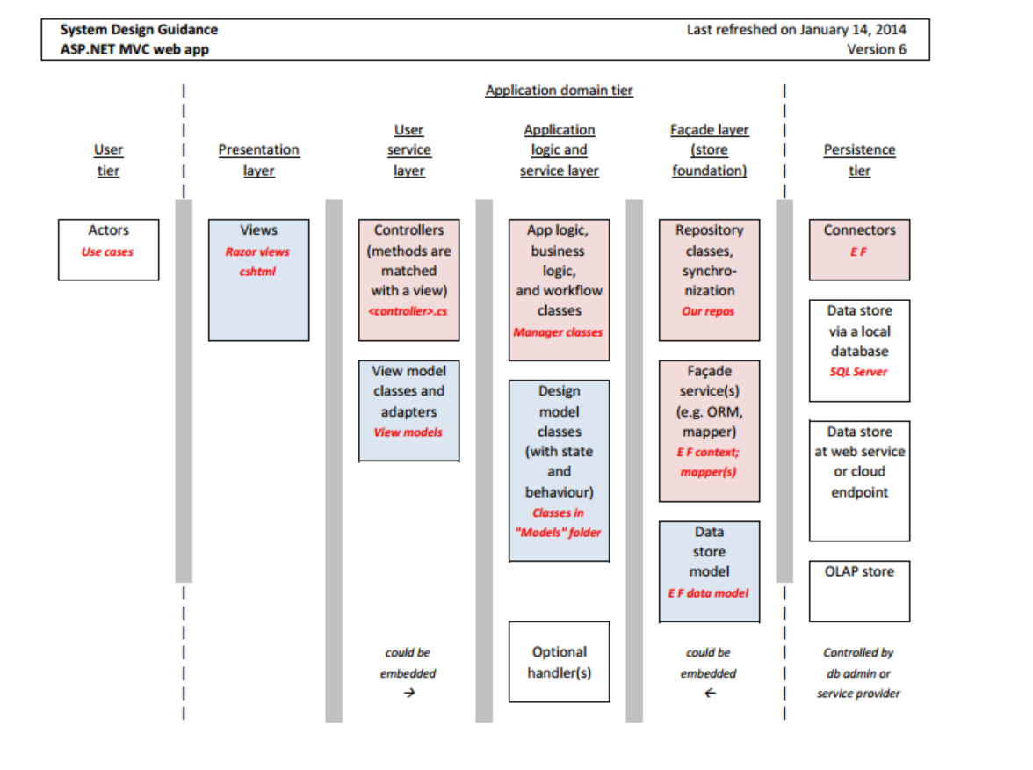

Slide 10
UI Layer
UI Controllers

Slide 11
Domain Controllers
Design Classes –attributes, operations and directional relationships

Slide 12
Persistence Facade—a special type of controller that gives us access to the persisted data store and surrounding functionality

Slide 13
Simple Start Example: Get Item Details
Class Diagram
Scenario: Get Item Details
Precondition:
Products are being displayed in a list on the screen. All item information has been retrieved from the database.
Actor | System
Selects item from the list | Displays item description and price

Slide 14
Simple Start Example: Get Item Details
Class Diagram
Scenario: Get Item Details
Precondition:
Products are being displayed in a list on the screen. All item information has been retrieved from the database.
Actor | System
Selects item from the list | Displays item description and price

Slide 15
Adding the Domain Layer: Get Item Details

Slide 16
Adding the Entity Manager Layer: Get Item Details

Slide 17
Exporting our Classes
public class UIController {
void enterItem();
};
public class DomainController {
void getItemDetails();
};
public class Item {
int itemNum;
int itemdesc;
int price;
void getDesc();
void getPrice();
};
public class EntityManager {
void get();
};

Slide 18
Controllers

Slide 19
Control Classes (“Controllers”)
Control and coordinate the behavior (logic!) of the system
Delegate the work to other classes who have the responsibility for carrying out specific tasks (e.g. creating a sale line item).
A control class should never do anything except for directing.
Control classes can decouple layers:
the UI from the business domain layer.
the business domain layer from the persistence layer (Façade)
Facades are a specialized type of controller—they simplify interfaces to more complex subsystems.

Slide 20
Controller Methods

Slide 21
Models:
Use case model
Use case descriptions including scenarios
Use case diagrams
System level sequence diagrams
Domain model
Initial class definitions
Attributes
Relationships and multiplicity
Design model
Architecture
Packages
Object level sequence diagrams
Design level classes: state; behaviour; associations with directionality
We are here

Slide 22
Exercise 1
What operations/functions does each object in the previous diagram require to carry out the scenario?
:UIController
:DomainController
:Item (or I123:Item)

Slide 23
Exercise 2: Create SD to Update Item Price
Class Diagram
Scenario: Update Item Price
Precondition:
Item information for one item is being displayed on the screen; the system is in update mode.
Actor | System
The manager enters a new price and requests to change price. | Sets the new price and displays the new price and item description along with a message saying “Please press confirm to save changes to database”

Slide 24
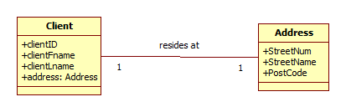
Exercise 3: Create SD to Get Postal Code
Class Diagram
Scenario: Get Client Postal Code
Precondition:
A list of client id’s and names is displayed. All clients and their addresses have been retrieved from the database.
Actor | System
The manger selects a client. | The system displays the postal code of the client address.

